Slide 1

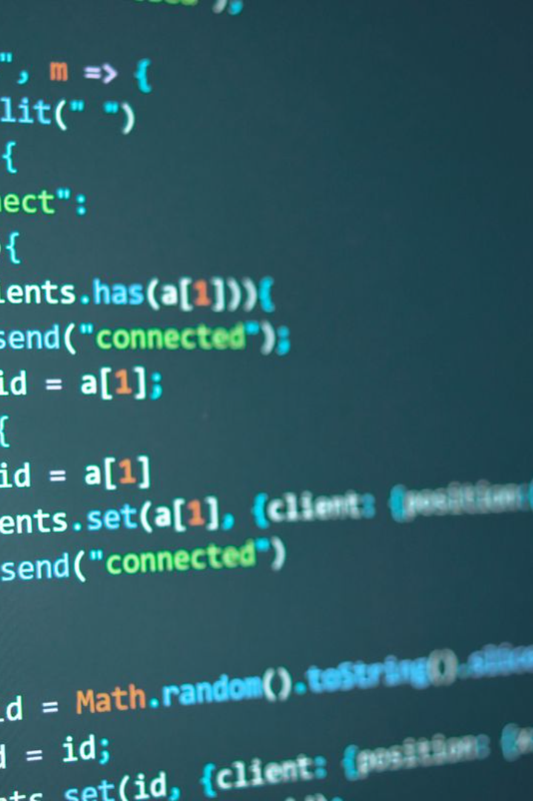
Operators in C Language
In this presentation, we will dive into the world of operators in C language, exploring their definitions, symbols, and examples in detail.

Slide 2

Arithmetic Operators
1
Definition and Symbols
2
Examples
Explore the usage of arithmetic operators: + (addition), - (subtraction), * (multiplication), / (division), % (modulus).
Arithmetic operators perform mathematical operations on operands.

Slide 3

Increment and Decrement Operators in C
The increment (++) and decrement (--) operators are used to increase or decrease the value of a variable by 1. They are unary operators and can be used both as postfix and prefix operators. e.g.: ++x, x++ and -- x, x--
These operators are commonly used in loops and other scenarios where you need to modify the value of a variable by a fixed amount.

Slide 4

Relational Operators
1
Definition
2
Symbols
Relational operators help compare values and determine relationships between operands.
Discover the power of relational operators: == (equal to), != (not equal to), > (greater than), < (less than), >= (greater than or equal to), <= (less than or equal to).

Slide 5

Logical Operators
1
Definition
2
Symbols
Logical operators combine conditions and provide logical outcomes.
Uncover the logic behind the logical operators: && (logical AND), || (logical OR), ! (logical NOT).

Slide 6

Bitwise Operators
1
Definition
2
Symbols
Bitwise operators manipulate individual bits of operands.
Dive into the fascinating world of bitwise operators: & (bitwise AND), | (bitwise OR), ^ (bitwise XOR), ~ (bitwise NOT), << (bitwise left shift), >> (bitwise right shift).

Slide 7
Assignment Operators
1
Definition
2
Symbols
Assignment operators assign values to variables.
Learn the art of efficient assignment: = (simple assignment), +=, -=, *=, /= (compound assignments), %=, &=, |=, ^=, <<=, >>= (bitwise compound assignments).

Slide 8
Ternary Operator
1
Definition
2
Symbols
The ternary operator provides a concise way to make decisions in C language.
Witness the power of the ternary operator in action: condition ? expression1 : expression2.

Slide 9
Operator Precedence in C
Precedence
Operator
Description
1
Parentheses
Operators within parentheses are evaluated first.
2
Unary
( ++ and --)
3
Multiplicative
(* and /) from left to right.
4
Additive
(+ and -) from left to right.
5
Relational
( < and >) from left to right.
6
Equality
( == and !=) from left to right.
7
Logical AND
Logical AND operator (&&)
8
Logical OR
Logical OR operator (||)
9
Conditional
( ? : )
10
Assignment
( = and +=) from right to left.

Slide 10
Wrap Up
Boost Your Programming Skills
Practice Makes Perfect
Continual Learning
Remember, the world of programming is ever-evolving. Keep learning and stay ahead in the game!
Mastering operators is key to becoming a skilled C programmer. Stay curious and explore further!
Put your knowledge into practice and challenge yourself with coding exercises using different operators.

